Slide 1


YouTube trending video analysis using python
Team Members :
2010030305 – Kollapudi Jeevan Kumar
2010030300 – Indla Harshitha
2010030262 – P . Arun Tej
2010030051 – Eranki Sumanth

Slide 2
Abstract :
Online video streaming platforms are heavily used nowadays.
Websites such as YouTube offers content creators a great platform to share their knowledge, ideas, and interesting information with their viewers.
For a video to reach the maximum number of people, YouTube offers a trending page on the website that shows videos that are trending at that particular time.
Other than a few viral videos that achieve a high view count which is predictable to end up in the trending section, the rest of the videos cannot be predicted.
Corporate companies are using social media for improving their businesses, data mining and analysis are very important these days.
Now we are going to deal with an analysis of YouTube Data on Trending Videos.
The analysis is done using user features such as Views, Comments, Likes, and Dislikes.
Analysis can be performed using algorithms like Linear Regression, classification, and other Machine learning models and python libraries like pandas, matplot library to classify the YouTube Data and obtain useful information.

Slide 3
Introduction :
YouTube is a widely used and famous online video platform in the world today.
YouTube has a list of trending videos that is updated constantly.
Analyzing these trending videos can give content creators greater perspective and knowledge for increasing the popularity and brand of their channels.
Companies and businesses using social media and digital platforms can also use this analysis to boost their growth in business by publishing videos or sponsoring appropriate channels at right time.
Now here we are going to find, measure, analyze, and compare key aspects of YouTube trending videos.

Slide 4
Literature Review :
Dataset used for analysis are of 2017-2018 and 2019.
In this analysis, all trending videos for the year 2017-2018 were analyzed (more than 40,000 videos) and in 2019 (more than 70,000 videos).
To check the similarity between those videos, have to analyze these data to get the perception of trending videos.
The Dataset that we have used is obtained from the internet.
We will analyze USA trending videos.
We also have a dataset of 2000 non-trending videos for comparing it with 2000 trending videos.

Slide 5
Context | Link | Authors | Method
Statistical Measures for Trending Video Analysis | https://iopscience.iop.org/article/10.1088/1757-899X/1131/1/012008/pdf | Pradhan, Rahul, Akansha Saxena, Divyanshi Bansal, and Ananya Jain. "Statistical Measures for Trending Video Analysis using knowledge pre-processing and preliminary knowledge Analysis." In IOP Conference Series: Materials Science and Engineering, vol. 1131, no. 1, p. 012008. IOP Publishing, 2021. | Hard statistics comparing key aspects of time-series YouTube data
Socio-computational Analysis of Trending YouTube Videos | http://sbp-brims.org/2018/proceedings/papers/latebreaking_papers/LB_14.pdf | Pradhan, Rahul, Akansha Saxena, Divyanshi Bansal, and Ananya Jain. "Statistical Measures for Trending Video Analysis using knowledge pre-processing and preliminary knowledge Analysis." In IOP Conference Series: Materials Science and Engineering, vol. 1131, no. 1, p. 012008. IOP Publishing, 2021. | Understanding consumer

Slide 6
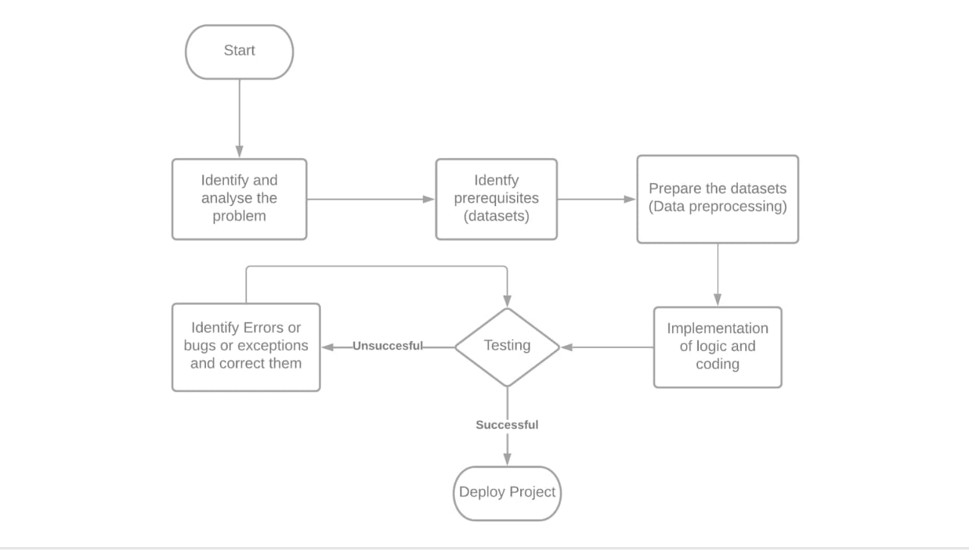
Flow Diagram :

Slide 7
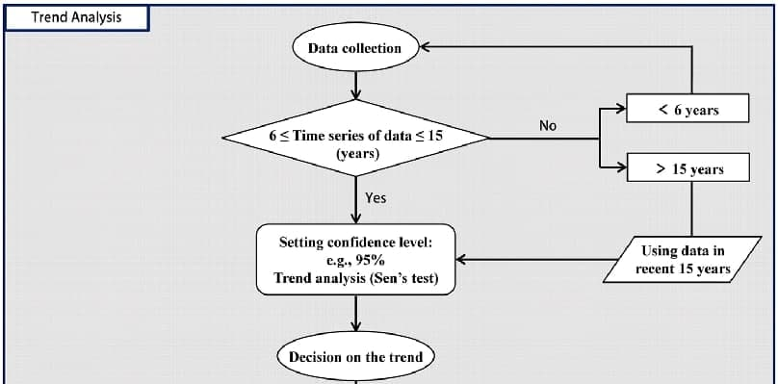

Slide 8
Methods :
Some of the methods that can be used for analysis are:
1. Classification:
It is a process of creating classes that represent users and use cases. Class Probability Estimation tries to predict how to classify each single individual data asset. Based on the specific question to be answered, classes are created. Other qualities of the asset are evaluated in making the prediction.
2. Regression:
The most commonly-used forecasting method is the Regression method. Regression can be confused with classification methods because to predict an outcome, the process of using known values is the same. It is a model used to predict continuous value. Linear regression, Logistic Regression, Polynomial Regression are some types of regression.

Slide 9
3. Clustering :
Clustering is a technique that involves the grouping of data points. We can use this algorithm for the classification of each data point into a specific group. The data points which are grouped will have similar features while those are in different groups will have highly dissimilar features. We need to identify how much data is linearly correlated to each other hence to find a correlation some analysis is required.[4]
4. Similarity Matching :
Similarity Matching looks for the correlation of attributes in order to recognize similarities between individuals. If two customers or products are similar in certain ways, it’s reasonable to predict that they will be similar in other ways as well. This can be used to find customers for targeted marketing campaigns or for managing the company’s image with targeted online ads. The similarity profile will reflect characteristics that will have a bearing on the question at hand, so it could include attributes such as age and purchase history.

Slide 10
Result :
Characteristics | 2017-2018
Dataset | It consists data more than 40,000 trending videos.
Video Title Length | Title length between 30 and 60 characters
Largest Category | Entertainment
Largest Channel | Largest Channel is ESPN
Common words in Video Titles | Official, Video, Trailer, How,2018
Views, Likes, Comments | Trending videos of 71% has views less than 1.5 million .Trending videos of 68% has likes less than 40,000.Trending videos of 67% has comments less than 4,000
Published Day and Time | Best hours are: On Monday, Tuesday and Wednesday from 2pm to 4pm and on Thursday and Friday from 12 pm till 3 pm.
Video appeared on the Trending list | On trending list videos may appear for more than one day.
Correlation of Trending videos | The highly positively correlated which has correlation value as- Views and Likes: 0.85 Between Likes and Comments: 0.80 Between
Thumbnails | Not Analyze

Slide 11
Characteristics | 2019-2020
Dataset | It consists data more than 70,000 trending videos in dataset.
Video Title Length | Title length between 36 and 64 characters
Largest Category | Entertainment
Largest Channel | Technology (Linus Tech Tips)
Common words in Video Titles | Official,Video,2019,vs,Trailer,music, Game, new, highlights, first, challenge
Views, Likes, Comments | The video which is most liked ,viewed and commented was BTS song ‘Boy With Luv’. Published Day and Time Publishing trending videos h
Published Day and Time | Publishing trending videos hours were between 4 PM and 6 PM.
Video appeared on the Trending list | And on average, videos takes 1.5 days to become trending. On trending list, 97% of the videos appear for 2 days after publishing video.
Correlation of Trending videos | The highly positively correlated which has correlation value as- Views and Likes: 0.81 Comments and Views: 0.61
Thumbnails | A person is the most common object in the thumbnails (Using ObjectDetection algorithm).

Slide 12
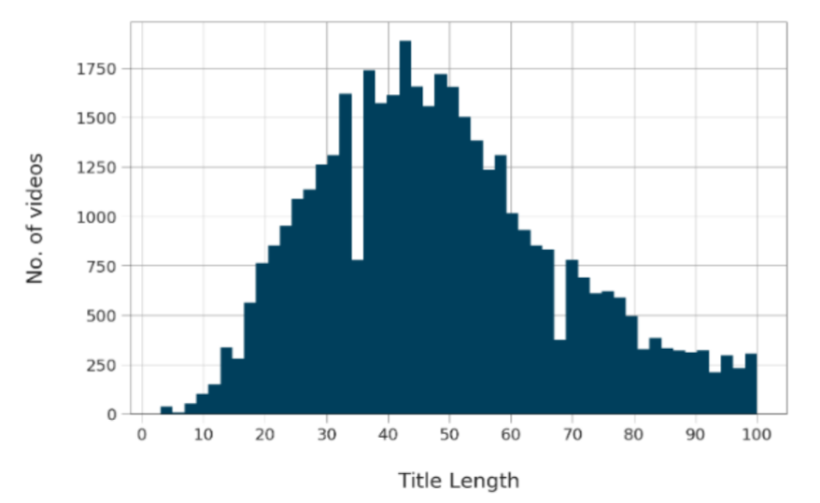
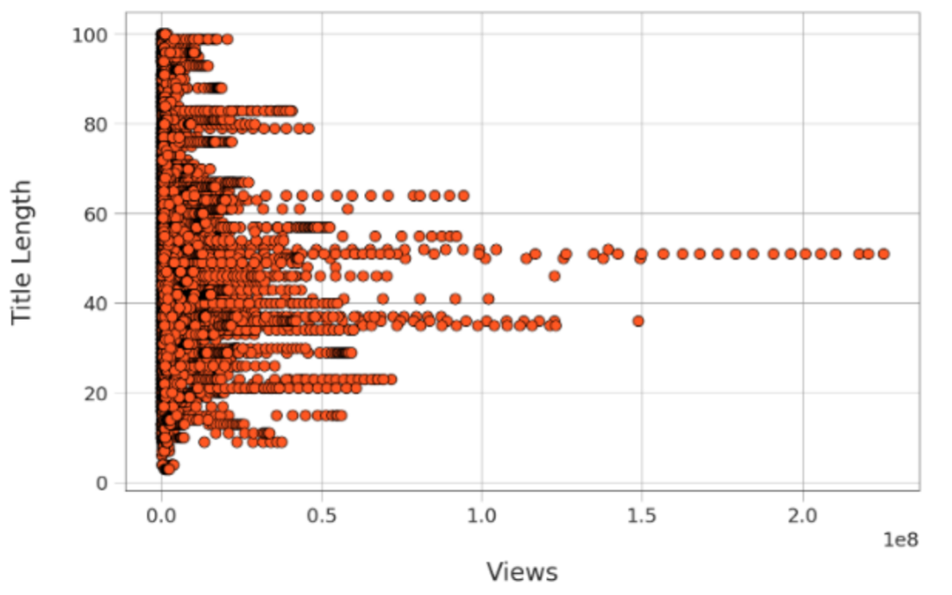
Discussion :
ANALYSIS ON VIDEO LENGTH
This is one of the key parameter which YouTube uses to mark the videos priority in trend.
Below graph shows title character length for each count of videos, where most videos have title length between 30 and 60 character approx.
Different graphs such as bar graph and scatter plot can be used to understand relationship between title length and view.
Figure 1 : Title character length for each count of videos in bar graph
Figure 2 : Title length character for each view count in scatter plot

Slide 13
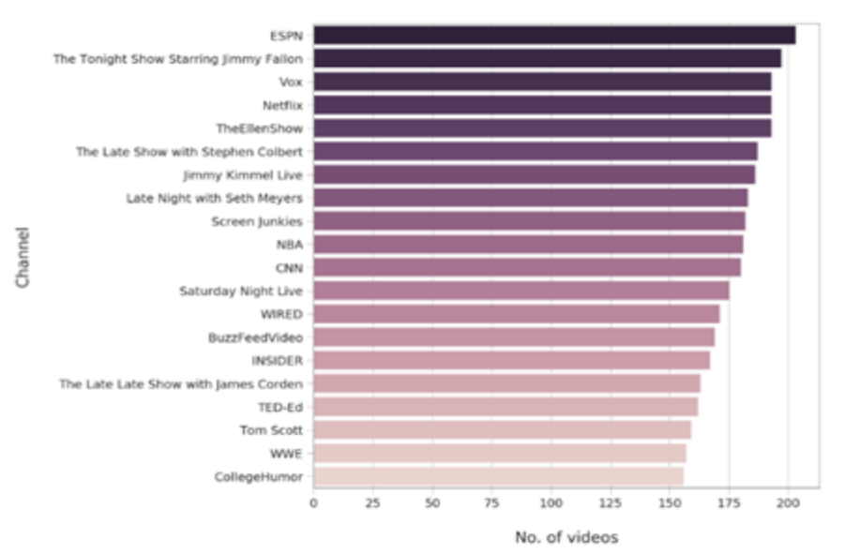
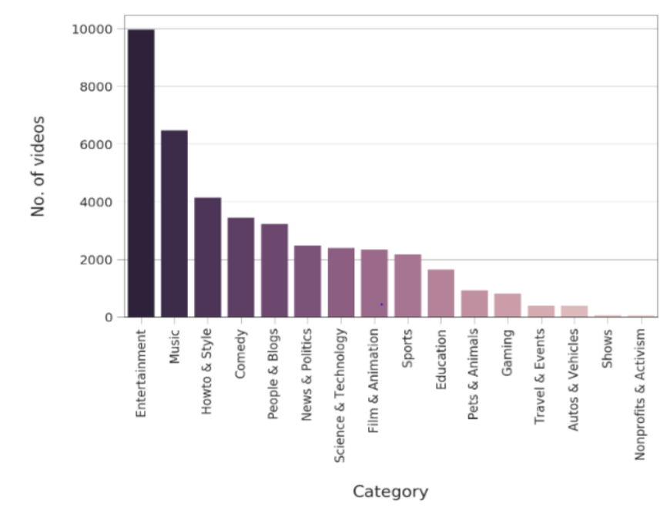
ANALYSIS ON CHANNELS
Just by counting channels and trending videos number we can get which channels produce most trending videos.
This can be done using the using functions from panda’s libraries on data frame containing the number of times the channel was on trending section.
ANALYSIS ON CATEGORY
Machine learning algorithms such as classification can be used to classify the categories of videos with their number of trending videos count to understand which category has more trending videos.
Figure 3 : Shows the channels which have largest number of trending videos
Figure 4 : Shows the channels which have the largest number of trending videos

Slide 14
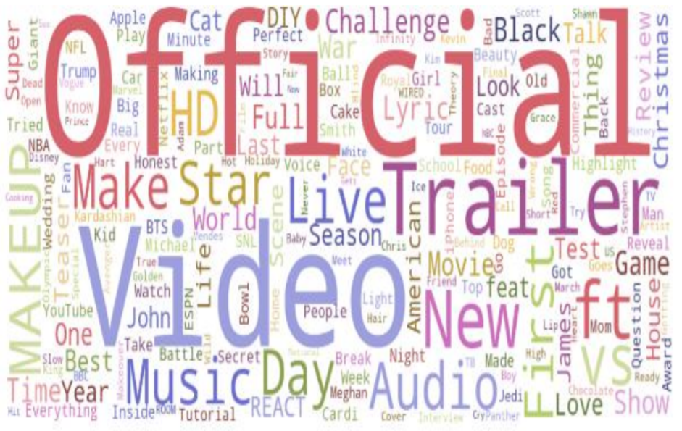
ANALYSIS ON KEYWORDS
The most common words in video titles after removing the usual structuring words such as articles, prepositions, and combining words such as a, an, the, but, etc.
We observe that the symbols "|" and “-" occurred several times in trending video titles 11452 to 10663 times. The common words in Trending video titles we noticed are “Trailer”, “How”,”2018” and “Videos” each occurring in 1613-1901 video titles.
Figure 5 : Shows most used keywords in trending videos

Slide 15
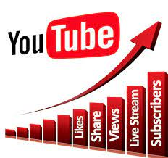
COMMENTS, LIKES, AND RATINGS
Correlation represents a value between +1, 0, and – 1 where +1 denotes highly positive correlation, -1 denotes highly negative correlation and 0 denotes No correlation.
The highly positively correlated which has correlation value as-Between Views and Likes: 0.85, Likes and Comments: 0.80, Dislikes and Comments: 0.70.
There is some positive correlation between Views and Dislikes, Views and Comments, Likes and Dislikes. Some Results obtained by observing comments like ratings are we see only 2% off Trending Videos prevented users from commenting. We see that only 169 trending videos out of 40949 prevented users from commenting. Videos have both comments and ratings disabled. So there are just 106 trending videos that have both comments and ratings disabled.

Slide 16
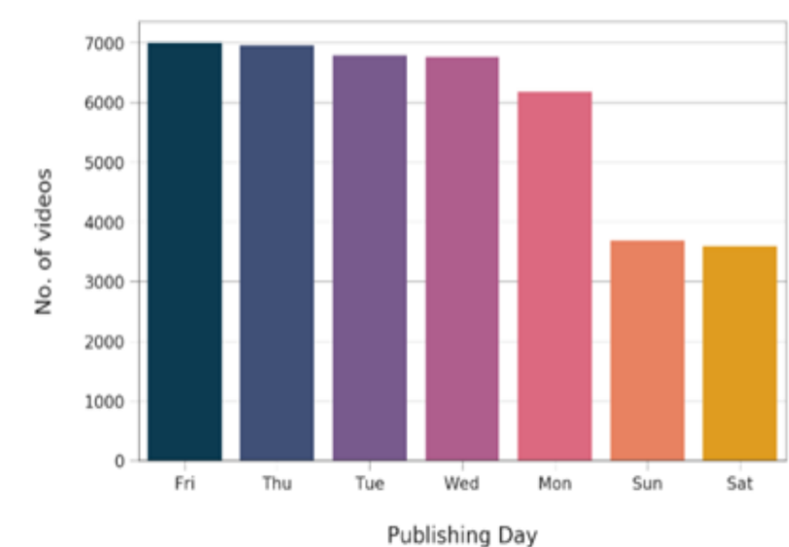
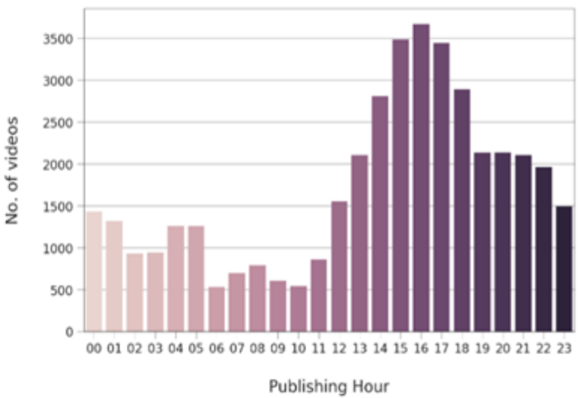
ANALYSIS ON BEST TIME TO UPLOAD VIDEOS
Some summaries after doing analysis on day and time are the Best day and time to upload video on YouTube is in midweek afternoons.
Best hours are: On Monday, Tuesday and Wednesday from 2pm to 4pm and on Thursday and Friday from 12 pm till 3 pm. After collecting data from 120 million views of total 1300 channels, we can know on weekends ,the best time to upload videos is between 9 to 11 am. To post videos on YouTube from all the days of week, Thursday and Friday are best.
Most YouTube viewers are children’s or Teens. The viewership extends on Thursday, increases on Saturday and then decreases on Sunday afternoon. In weekdays, the best time to upload videos on YouTube is between 2pm and 4pm.You may think it’s early but YouTube traffic is high in the evening between 7pm and 10pm.
Trending videos and their time
Number of Videos published per hour

Slide 17
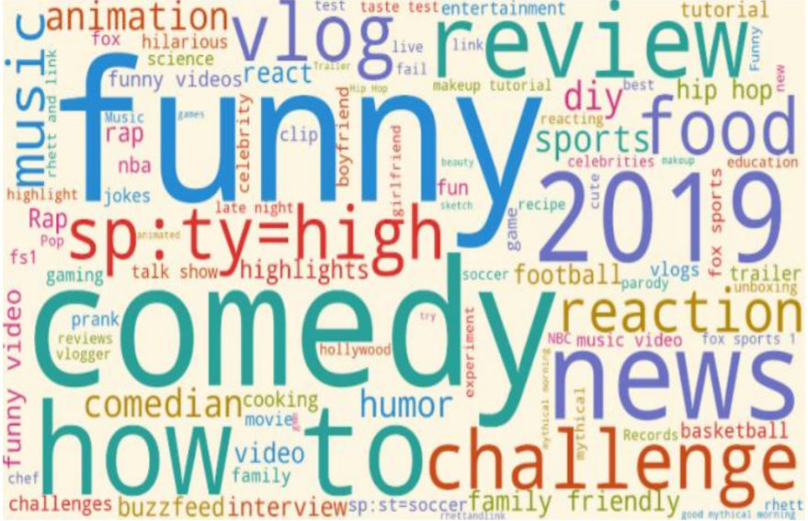
ANALYSIS ON VIDEO TAGS
When you upload a video to YouTube, you can add tags to the video. Tags cannot display on the video page but you can see tags by viewing the source code of the page or using browser extensions such as Tubebuddy and vidIO.
1. Trending videos have 21 tags as of average. 2. Only 3.5% of trending videos have no tags. 3. The minimum number of tags a trending video has is 0.
Once again by using the word count library and matplotlib we can create an image consisting of the most number of words used in these tags.
Common words in Trending Video Tags

Slide 18
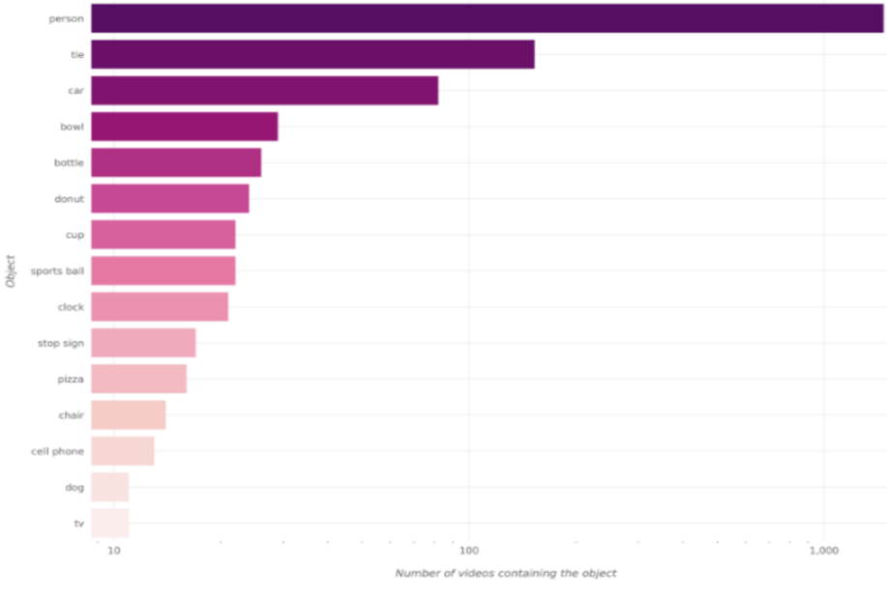
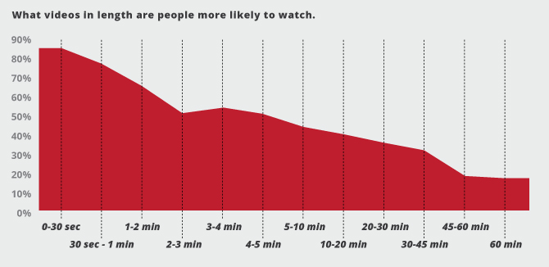
ANALYSIS ON VIDEO THUMBNAILS
Apart from video titles, thumbnails play a very important role in making users click on videos to watch based on the contents in the thumbnails. Using object detection libraries with python such as OpenCV, imageAIi, TensorFlow we can identify objects in thumbnail by estimating their percentage probability and then counting the probabilities for each object such as people, car, Text we can understand what are the best items that can be shown as a thumbnail for a video. So a person image appears more than 1,000 times in trending videos thumbnails.
VIDEO DURATION
By comparing video duration and view count of trending videos we can understand the best duration for a trending video is has. Trending videos between 2 to 20 minutes long are highest in rank than videos that are 2 minutes long on average. If they use storytelling techniques to maintain and build interest throughout the video – generally rank higher than very short videos. So, video duration influences rank ability, but so does the ability to tell a good story. The study found that 10-16 minute videos are well-liked.
Best items that can be shown as a Thumbnail for a Video.

Slide 19
Tips to make youtube video trending :
Create Long-Form Video Content
Promote Your Video Quickly
Use an Engaging Thumbnail
Optimize Meta Data for Better Search and Visibility
Stick With Your Brand’s Image
Be a Consistent YouTuber

Slide 20
Conclusion :
So, we presented our findings for measuring, analyzing, and comparing key aspects of YouTube trending videos.
To know the only best time to upload a video on YouTube is not enough to generate millions of views for your Videos to become a trend.
There are some other factors to consider are Good Titles, Good thumbnails, Video SEO, proper tagging, and the number of subscribers are all factors that are key to generating views for your content.
Understanding these Statistics will not only help YouTube to develop better algorithms to process videos but also benefit to make decisions for individual YouTubers.

Slide 21

Thank you

